Slide 1


Program and Project

Slide 2
Project
“a temporary organization that is created for the purpose of delivering one or more business products according to a specified business case”.
is a specific, single task that delivers a tangible output,
Projects have an end and aren’t designed to last very long. The project manager ensures the project delivers the intended goal, within a defined timeframe and budget.

Slide 3
Program
is simply a larger, longer version of a project.
is a collection of related projects.
“a group of related projects managed in a coordinated way to obtain benefits and control not available from managing them individually”.
are usually long term, sometimes spanning years, and don’t have a fixed deadline.
is a framework of related projects aligned in a specific sequence. They have predictable and repeatable elements to minimize or even eliminate risks.

Slide 4
Comparison | Project | Programme
Focus | Content | Context
Scope | Well-defined, limited to an output | Broad and adjustable
Timeframe | Short term | Long term
Components | Small tasks | Projects
Functional units | Single | Multiple
Tasks | Technical | Strategic
Produces | Output | Outcome
Deadlines | Strict | Flexible
Designers | Mid-level staff | Top-level staff
Success | Product quality, timeliness, cost effectiveness, compliance and customer satisfaction | Long-term benefits to the organization, ROI or new capabilities

Slide 5
Project and program Similarities
Are temporary
Use (business/educational) cases
Require a team
Are aligned to strategic objectives
Deliver change

Slide 6
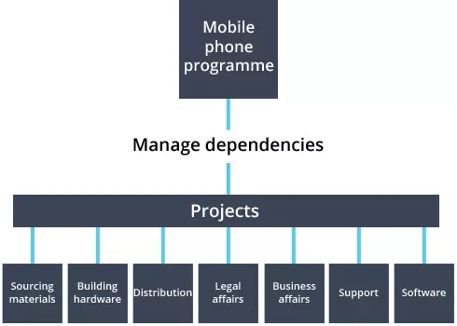
https://www.prince2.com/uk/blog/project-vs-programme

Slide 7
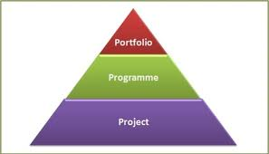
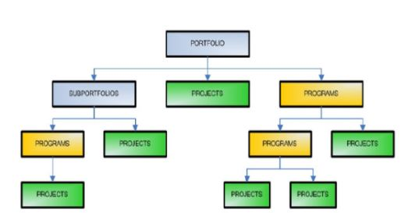
A portfolio organizes programs, projects, sub-portfolios, sub-programs, and operations to facilitate business benefits (i.e., maximize profitability).
https://www.simplilearn.com/difference-between-projects-and-programs-article

Slide 8
Project managers vs Program managers
Project managers focus on the project’s deliverables, making sure the project reaches its intended outcome on time and within the budget.
Program managers are usually less hands-on, but must view the bigger picture and visualize the benefits that individual projects will have on the whole program.

Slide 9
Project managers vs Program managers
Comparison | Project manager | Programme manager
Role | Monitor and control project tasks | Monitor and control projects
Focus | The project staff, i.e. technicians and specialists | Managing relationships with project managers and their teams, freeing up resources and resolving conflicts
Who they manage | The project team | Other managers
Planning level | Creates a detailed project plan for the resources, cost, timeliness and delivery | Creates high-level plans used by the project managers both as a guide and to develop the detailed plans

Slide 10
biggest difference
Projects deal with delivering strictly defined outputs within a specific timescale and budget,
Programs deal with delivering outputs that benefit the entire organization.
Put simply, projects involve ‘doings things right’ and programs involve ‘doing the right things’. Similar phrases, but very different meanings.

Slide 11
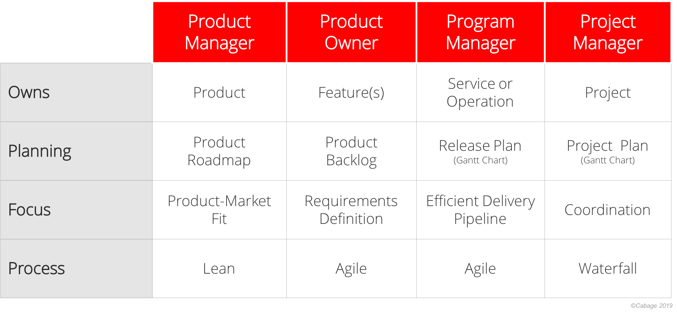
PRODUCT VS PROJECT VS PROGRAM MANAGEMENT
https://nealcabage.com/product-vs-project-vs-program-management/

Slide 12

List-of-Programs-and-Projects
https://www.deped.gov.ph/wp-content/uploads/2020/02/List-of-Programs-and-Projects-Beneficiaries.Finals.V2.pdf
https://www.facebook.com/DepartmentOfEducation.PH/
https://bee-dep-ed.tripod.com/id2.html
https://www.projectawe.net/elementary-programs
https://www.projectawe.net/elementary-programs

Slide 13
Simplilearn (2021). Know the Difference Between Projects and Programs. Retrieved on September 10, 2021 from https://www.simplilearn.com/difference-between-projects-and-programs-article
Product VS Project VS Program Management. Retrieved on September 10, 2021 from https://nealcabage.com/product-vs-project-vs-program-management/
Programs vs Projects. Retrieved on September 10, 2021 from https://www.prince2.com/uk/blog/project-vs-programme.

